Slide 1
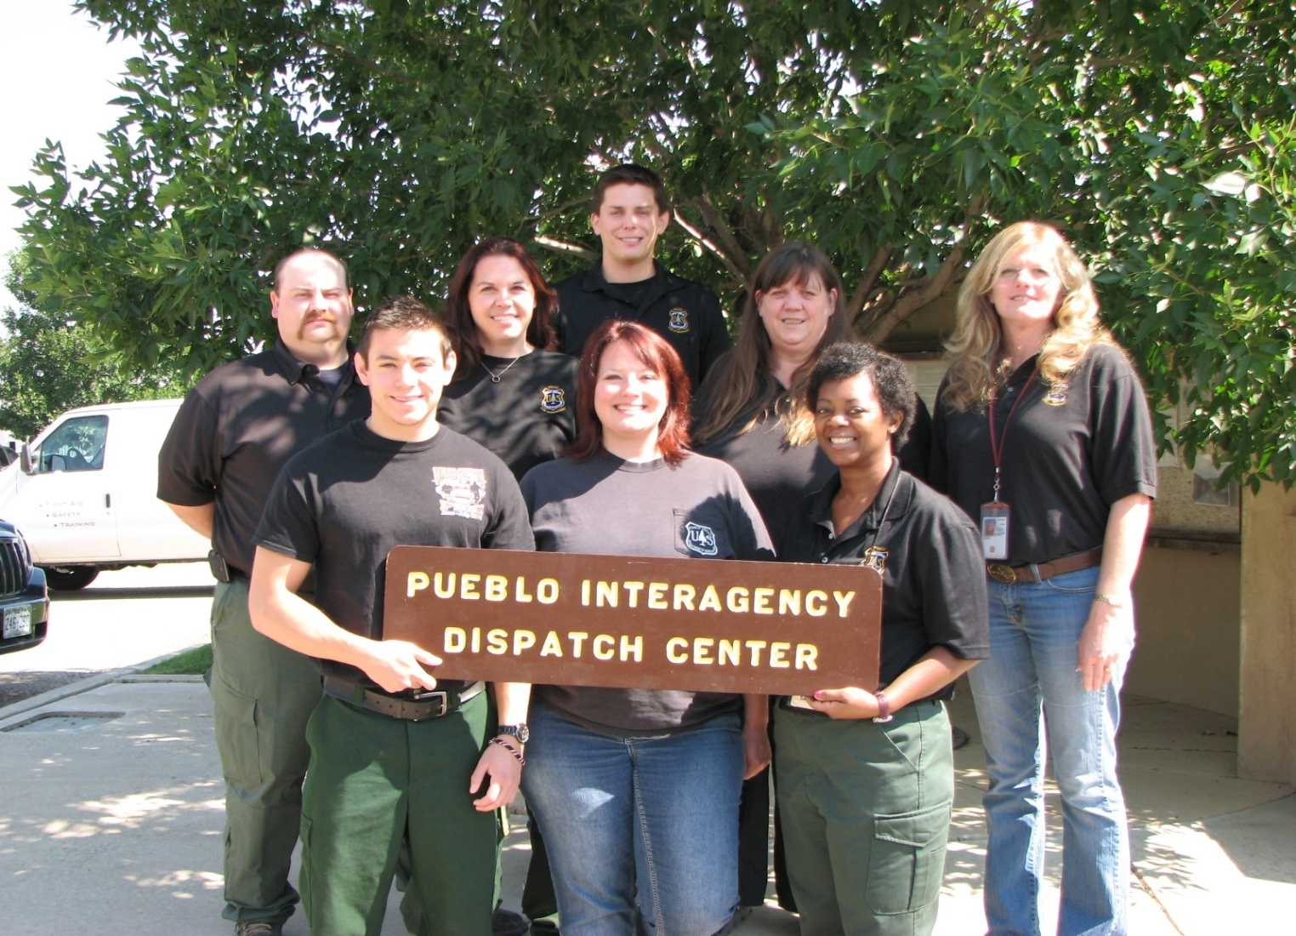
NARRATIVE
2013 PUEBLO INTERAGENCY DISPATCH CENTER
ANNUAL REPORT

Slide 2
narrative
The Pueblo Interagency Dispatch Zone experienced an average fire season during 2013, with an above average amount of large fires within a short period of time. The zone also experienced large scale flooding, affecting several counties. Interagency coordination was activated to support community efforts. For the first time in several years Kansas had only one large fire compared to the average of ten.
Colorado fuels continued to show drought stricken reading throughout the winter.
The San Luis Valley had the first large fire (April 29th Stockade) in Conejos County/San Luis District-BLM for 918 acres. This fire was the first of 5 large fires for the San Luis Valley.
June held the largest activity for the Pueblo Dispatch Center. It supported and mobilized 14 Incident Management teams for 8 large fires between the dates of June 11 through June 20th.
On June 11 in a span of three hours we started support of the Royal Gorge, Black Forest and Klikus fires. All three fires occurred in urban settings with immediate evacuations and team orders.
The next surge of fires occurred on June 19th; the start of Lime Gulch, Bull Gulch, East Peak, Papoose (West Fork Complex).

Slide 3
NARRATIVE
The utilization and coordination of aviation assets for initial attack and large fire support, lead to the success of safe fire suppression within the zone. The usage of the Pueblo Reload Tanker Base provided Colorado the opportunity to utilize the VLAT (Very Large Air Tanker) and MAFFS (Modular Airborn Firefighting Systems) programs.
Pueblo Dispatch activated expanded dispatch for 50 days and ran 24 hour staffing for 63 days. We started 7 day staffing in April and ended in November. We successfully filled our Center Manager Position (Tammy Milton) and the Rio Grande 18/8 dispatch position (Kymberli Hoffman) fulfilling dispatch vacancies.
On the Horizon, the dispatch center staff continues to support the partnerships with agency dispatch centers and OEM offices. We will continue to host our yearly Pueblo Zone Workshop providing interaction and training to county dispatchers and OEM personnel.
A special thanks to all the agencies, the Pueblo Zone Fire Board and Dispatchers that assisted the center this year.

Slide 4
STATISTICS
BLACKFOREST

Slide 5
Incident Totals: 1,193

Slide 6
Incidents by Agency

Slide 7
Colorado Incidents by County: 232

Slide 8
Kansas Incidents by County: 5

Slide 9
Incidents by Day

Slide 10
Incidents by Hour

Slide 11
Red Flag Warning Incidents: 79

Slide 12
5 Year Average of Incidents: 1,464

Slide 13
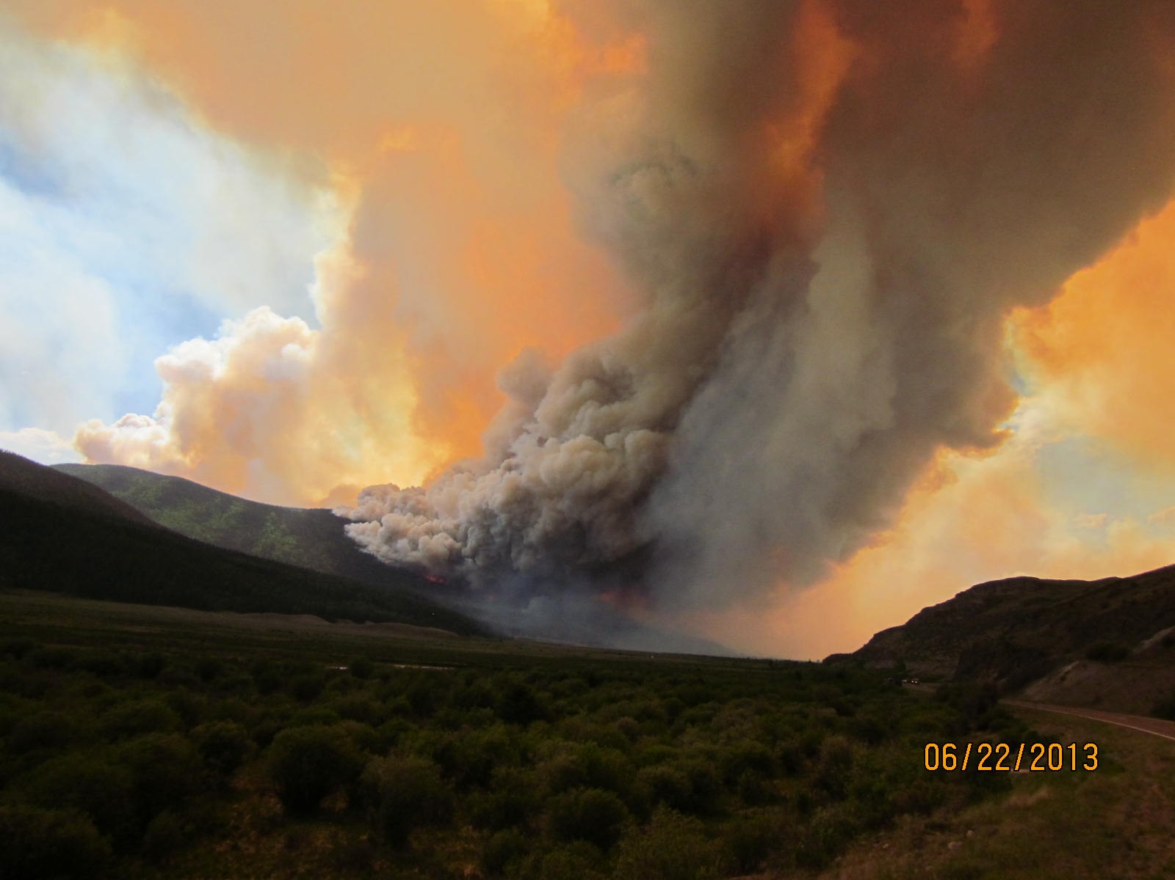
FIRES AND ACRES
FIRES and ACRES TOTALS
PAPOOSE

Slide 14
Fire and Acres by Agency

Slide 15
PSICC 99 Fires / 3,347 Acres & RGF 21 Fires / 89,388 Acres

Slide 16
RGD 27 Fires / 847 Acres & SLD 4 Fires / 903 Acres

Slide 17
County Fires and Acres

Slide 18
251 Fires / 131,727 Acres by Month

Slide 19
Stat Cause by Month

Slide 20
5 Year Average: 336 Fires / 115,188 Acres

Slide 21
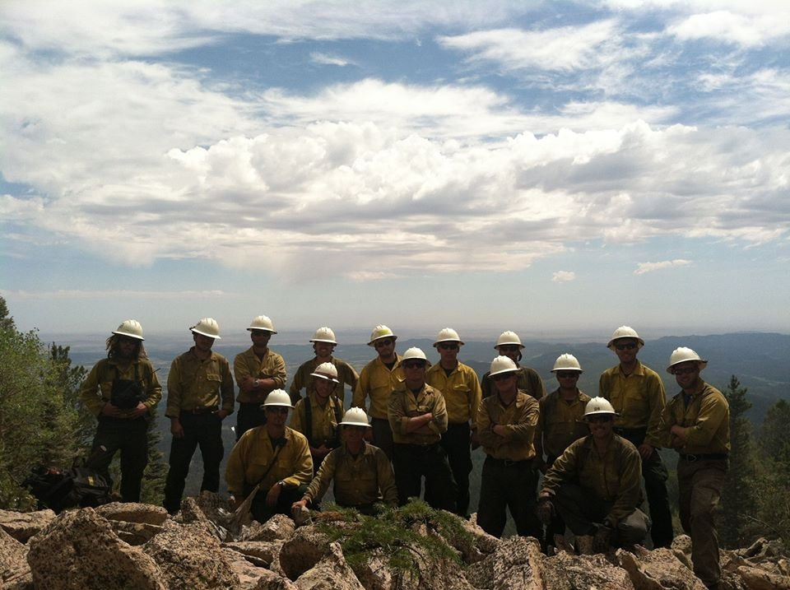
2013 Resource orders overhead, engines, aircraft and crews IN AND OUT OF ZONE ASSIGNMENTS
Mid-plains Crew – East Peak Fire

Slide 22
OVERHEAD INZONE 1129 REQUEST FOR 27 INCIDENTS

Slide 23
OVERHEAD OUT OF ZONE 461 REQUEST FOR 112 INCIDENTS

Slide 24
ENGINES IN ZONE 218 REQUEST FOR 17 INCIDENTS

Slide 25
ENGINES OUT OF ZONE 84 REQUEST FOR 28 INCIDENTS

Slide 26
CREWS IN ZONE 115 REQUEST FOR 23 INCIDENTS

Slide 27
CREWS OUT OF ZONE 32 REQUEST FOR 29 INCIDENTS

Slide 28
Aircraft In Zone: 304 Requests / 38 Incidents

Slide 29
Aircraft Out of Zone: 39 Requests / 13 Incidents

Slide 30
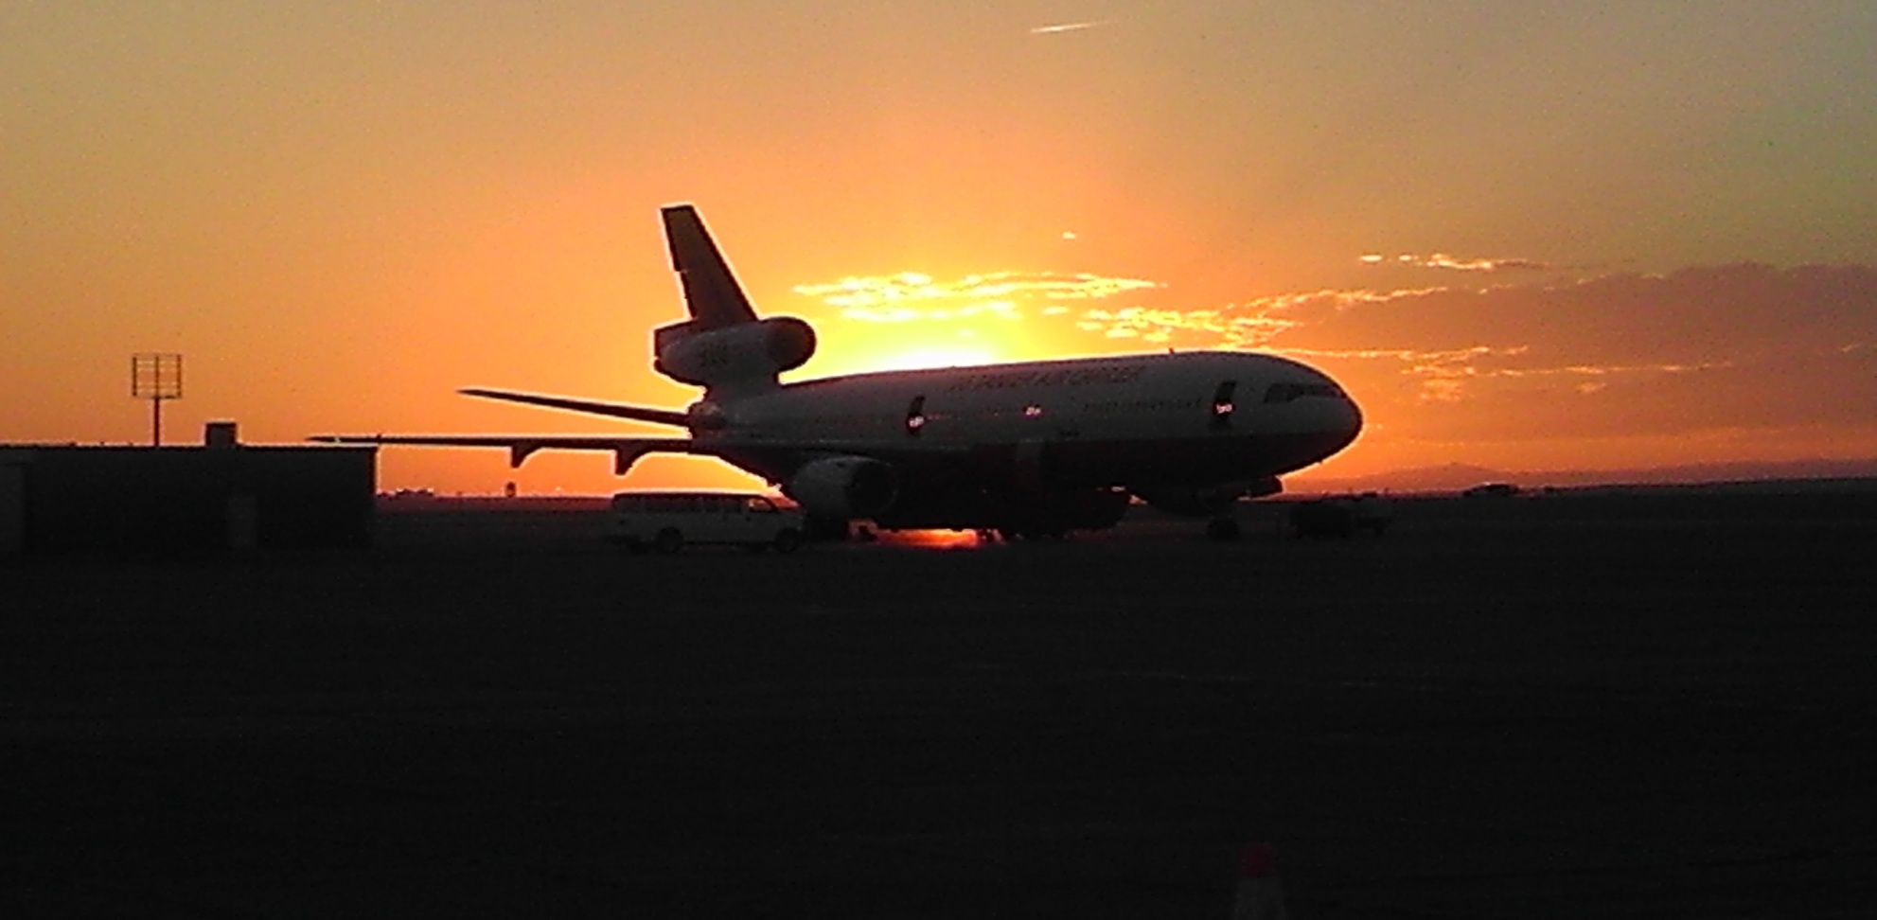
PUEBLO RELOAD TANKER BASE
TANKER BASE’S USAGE AND CONTRACTED HELICOPTERS

Slide 31
Tanker Base Totals

Slide 32
Monument Helitack-H966AC

Slide 33
TRAVEL

Slide 34
Travel 2013 460 Travelers / 197,573.41 Travel Cost

Slide 35
209 LARGE FIRES

Slide 36
Large Fire Stats
Inc. Name | Agency | Start Date | Cause | Ac. | Inc. Type
Konza | Ks-KSX | 3/29 | Hum | 300 | IC 4
Stockade | Co-CJX | 4/21 | Hum | 918 | IC 4
Streams Lake | Co-MLX | 5/31 | Hum | 130 | IC 4
Burrows Draw | Co-PSF | 6/4 | LTN | 308 | IC 4
Ox Cart | Co-RGF | 6/8 | LTN | 1,152 | IC 4 / IC 3 / IMT2 / IC 4
Royal Gorge | Co-RGD | 6/11 | Hum | 3,216 | IMT3 / IMT2
Black Forest | Co-EPX | 6/11 | Hum | 14,280 | IMT3 / IMT1
Klikus | Co-HUX | 6/11 | Hum | 75 | IC 3
Lime Gulch | Co-PSF | 6/19 | LTN | 511 | IC 3 / IMT2
Bull Gulch | Co-RGD | 6/19 | Hum | 76 | IC 3 / IC 4
East Peak | Co-HUX | 6/19 | LTN | 13,572 | IC 4 / IC 3 / IMT2 / IC 3 / IC 4
Papoose | Co-RGF | 6/19 | LTN | 3,000 | IC 2
Trickle Mountain | Co-SLD | 6/20 | LTN | 217 | IC 4
Pipeline | Co-LSX | 7/9 | LTN | 100 | IC 4 / IC 3
Crazy | Co-LSX | 7/10 | LTN | 45 | IC 4
Coal Creek Canyon Flood | Co-JEX | 9/12 | Flood | 385 sq mi. | IMT3
Impact Complex | Ks-DOD | 11/17 | Hum | 6,500 | IC 4

Slide 38
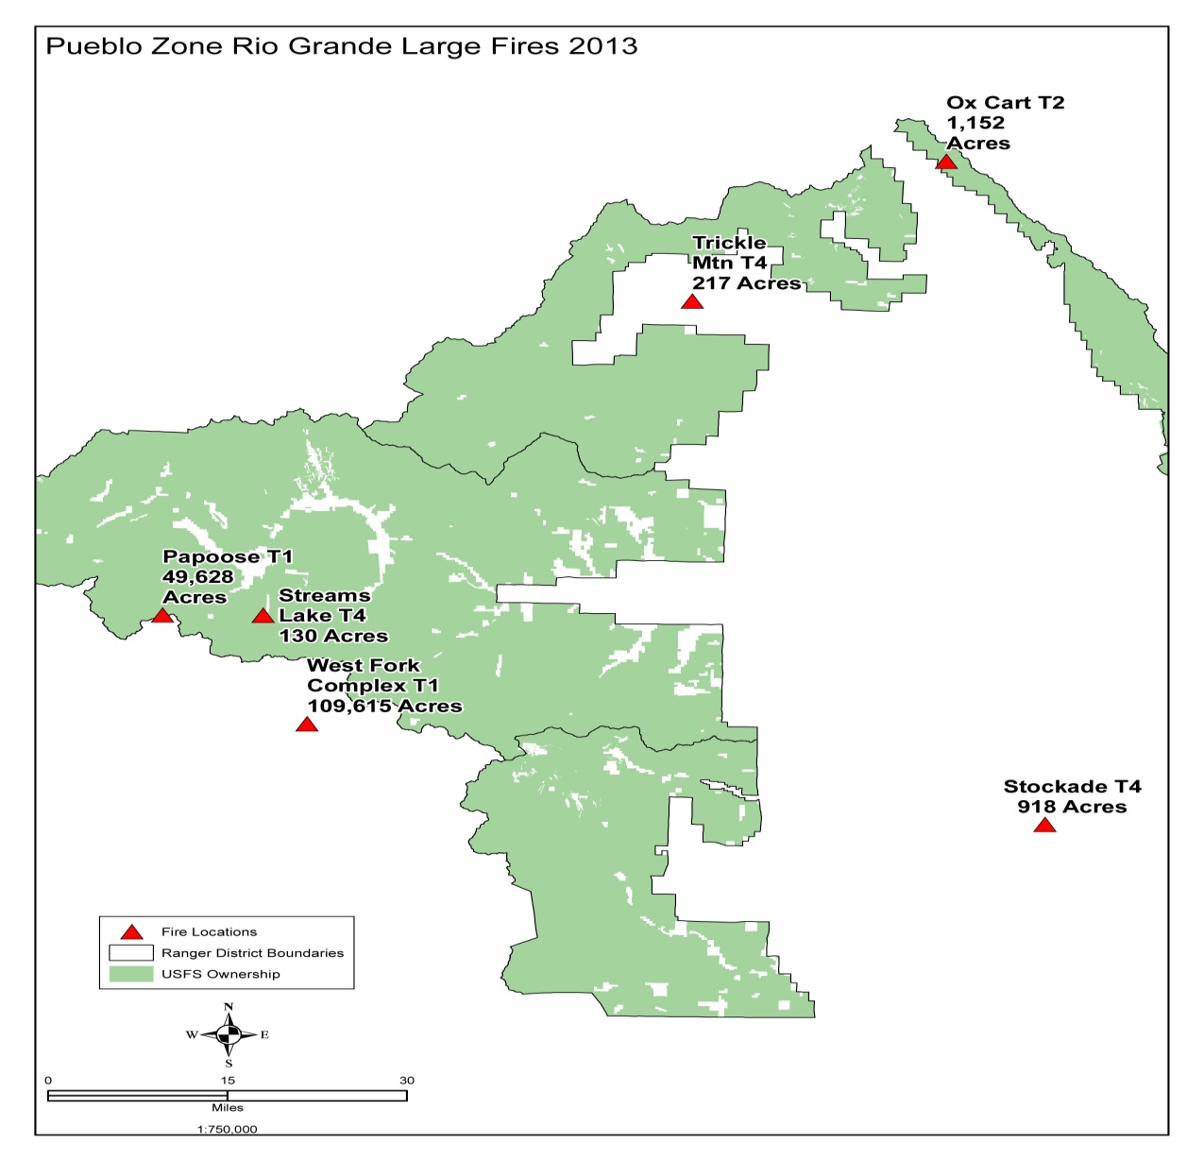

Slide 39
2013 Final Situation Report
Dispatch Office Summary Situation Report 12/31/2013 – Pueblo Dispatch

Slide 40
Year-to-Date |  | Wildland Fire Activity |  |  |  |  |  | Rx Fire Activity
Agency | State Unit | Human |  | Lightning |  | Total |  | Rx
 |  | Fires | Acres | Fires | Acres | Fires | Acres | Fires | Acres
BIA | KS-HOA | 4 | 2 | 0 | 0 | 4 | 2 | 0 | 0
BIA | Total: | 4 | 2 | 0 | 0 | 4 | 2 | 0 | 0
BLM | CO-RGD | 12 | 509 | 15 | 337 | 27 | 846 | 6 | 70
BLM | CO-SLD | 0 | 685 | 4 | 218 | 4 | 903 | 1 | 40
BLM | Total: | 12 | 1,194 | 19 | 555 | 31 | 1,749 | 7 | 110
CNTY | CO-ALX | 1 | 0 | 0 | 0 | 1 | 0 | 0 | 0
CNTY | CO-BAX | 0 | 0 | 1 | 0 | 1 | 0 | 0 | 0
CNTY | CO-BNX | 1 | 100 | 0 | 0 | 1 | 100 | 1 | 0
CNTY | CO-CFX | 2 | 0 | 0 | 0 | 2 | 0 | 5 | 0
CNTY | CO-CJX | 1 | 233 | 0 | 0 | 1 | 233 | 0 | 0
CNTY | CO-CTX | 0 | 0 | 0 | 0 | 0 | 0 | 3 | 7
CNTY | CO-CUX | 2 | 0 | 0 | 0 | 2 | 0 | 0 | 0
CNTY | CO-DGX | 1 | 2 | 1 | 1 | 2 | 3 | 0 | 0
CNTY | CO-EPX | 6 | 15,005 | 0 | 0 | 6 | 15,005 | 2 | 0
CNTY | CO-FRX | 4 | 2,719 | 4 | 1 | 8 | 2,720 | 0 | 0
CNTY | CO-HIX | 0 | 0 | 0 | 619 | 0 | 619 | 0 | 0
CNTY | CO-HUX | 5 | 90 | 3 | 10,858 | 8 | 10,948 | 0 | 0
CNTY | CO-JEX | 15 | 30 | 14 | 1 | 29 | 31 | 1 | 0
CNTY | CO-LKX | 2 | 0 | 3 | 101 | 5 | 101 | 2 | 0
CNTY | CO-LSX | 2 | 0 | 3 | 115 | 5 | 115 | 0 | 0
CNTY | CO-MLX | 2 | 130 | 0 | 33 | 2 | 163 | 0 | 0
CNTY | CO-OTX | 1 | 150 | 0 | 0 | 1 | 150 | 0 | 0
CNTY | CO-PAX | 3 | 0 | 2 | 0 | 5 | 0 | 2 | 0
CNTY | CO-PUX | 1 | 0 | 2 | 6 | 3 | 6 | 2 | 0

Slide 41
Year-to-Date |  | Wildland Fire Activity |  |  |  |  |  | Rx Fire Activity
Agency | State Unit | Human |  | Lightning |  | Total |  | Rx
 |  | Fires | Acres | Fires | Acres | Fires | Acres | Fires | Acres
CNTY | CO-SHX | 0 | 0 | 3 | 5 | 3 | 5 | 1 | 0
CNTY | CO-TLX | 13 | 5 | 1 | 3 | 14 | 8 | 0 | 0
CNTY | KS-KSX | 4 | 387 | 1 | 166 | 5 | 553 | 0 | 0
CNTY | Total: | 66 | 18,851 | 38 | 11,909 | 104 | 30,760 | 19 | 7
DDQ | CO-FCQ | 2 | 2 | 1 | 0 | 3 | 2 | 8 | 5,385
DDQ | KS-DDQ | 1 | 6,500 | 0 | 0 | 1 | 6,500 | 0 | 0
DDQ | Total: | 3 | 6,502 | 1 | 0 | 4 | 6,502 | 8 | 5,385
FWS | CO-ALR | 0 | 0 | 1 | 0 | 1 | 0 | 1 | 475
FWS | CO-BAR | 0 | 0 | 0 | 0 | 0 | 0 | 2 | 10
FWS | CO-LFR | 0 | 0 | 0 | 0 | 0 | 0 | 1 | 0
FWS | CO-MVR | 0 | 0 | 1 | 0 | 1 | 0 | 0 | 0
FWS | CO-RFR | 1 | 0 | 0 | 0 | 1 | 0 | 0 | 0
FWS | KS-KIR | 1 | 13 | 0 | 0 | 1 | 13 | 1 | 10
FWS | KS-MCR | 2 | 63 | 0 | 0 | 2 | 63 | 3 | 429
FWS | KS-QUR | 0 | 0 | 0 | 0 | 0 | 0 | 5 | 855
FWS | Total: | 4 | 76 | 2 | 0 | 6 | 76 | 13 | 1,779
NPS | CO-FFP | 0 | 0 | 1 | 0 | 1 | 0 | 0 | 0
NPS | KS-FSP | 0 | 0 | 0 | 0 | 0 | 0 | 1 | 5
NPS | Total: | 0 | 0 | 1 | 0 | 1 | 0 | 1 | 5
ST | CO-PBS | 1 | 0 | 2 | 0 | 3 | 0 | 0 | 0
ST | KS-KSS | 0 | 0 | 0 | 0 | 0 | 0 | 1 | 15
ST | Total: | 1 | 0 | 2 | 0 | 3 | 0 | 1 | 15
USFS | CO-PSF | 29 | 43 | 68 | 3,298 | 97 | 3,341 | 34 | 1,327
USFS | CO-RGF | 2 | 0 | 19 | 89,388 | 21 | 89,388 | 13 | 222
USFS | KS-PSF | 0 | 0 | 3 | 6 | 3 | 6 | 0 | 0
USFS | Total: | 31 | 43 | 90 | 92,692 | 121 | 92,735 | 47 | 1,549
Grand Total: |  | 121 | 26,668 | 153 | 105,156 | 274 | 131,824 | 96 | 8,850

Slide 42
Pueblo Dispatch Center
Thank you for your continued support

